Slide 1

Exploring: Microsoft® Excel® 2016 Comprehensive
First Edition
Chapter 4
Datasets and Tables Managing Large Volumes of Data
Copyright © 2017 Pearson Education, Inc. All Rights Reserved
Notes:
If this PowerPoint presentation contains mathematical equations, you may need to check that your computer has the following installed:
1) MathType Plugin
2) Math Player (free versions available)
3) NVDA Reader (free versions available)
Exploring: Microsoft® Excel® 2016 Comprehensive
In Chapter 4, you will learn how to use Excel to manage and analyze large data sets.

Slide 2
Objectives (1 of 2)
Freeze Rows and Columns
Print Large Datasets
Understand the Benefits of Data Tables
Design and Create Tables
Apply a Table Style
Create Structured References in Formulas
Notes:
The objectives for this chapter are:
Freeze Rows and Columns
Print Large Datasets
Understand the Benefits of Data Tables
Design and Create Tables
Apply a Table Style
Create Structured References in Formulas
Additional objectives are listed on the next slide.

Slide 3
Objectives (2 of 2)
Sort Data
Filter Data
Add a Total Row
Apply Conditional Formatting
Create a New Rule
Notes:
Additional objectives for this chapter include:
Sort Data
Filter Data
Add a Total Row
Apply Conditional Formatting
Create a New Rule

Slide 4
Objective 1: Freeze Rows and Columns
Skills:
Freeze Rows and Columns
Notes:
In this section, the skill is:
Freeze Rows and Columns

Slide 5
Freeze Rows and Columns (1 of 2)
Freezing—keeps certain rows and/or columns visible at all times
Freeze options:
Freeze
Freeze Top
Freeze First
Notes:
When working with large datasets, it is not unusual to scroll down or right and lose sight of column or row headings. Freezing is the process of keeping rows and/or columns visible onscreen at all times even when you scroll through a large dataset.
There are three freeze options:
Freeze Panes—keeps both rows and columns above and to the left of the active cell visible when scrolling through a worksheet.
Freeze Top Row—keeps only the top row visible when scrolling through a worksheet.
Freeze First Column—keeps only the first column visible when scrolling through a worksheet.

Slide 6
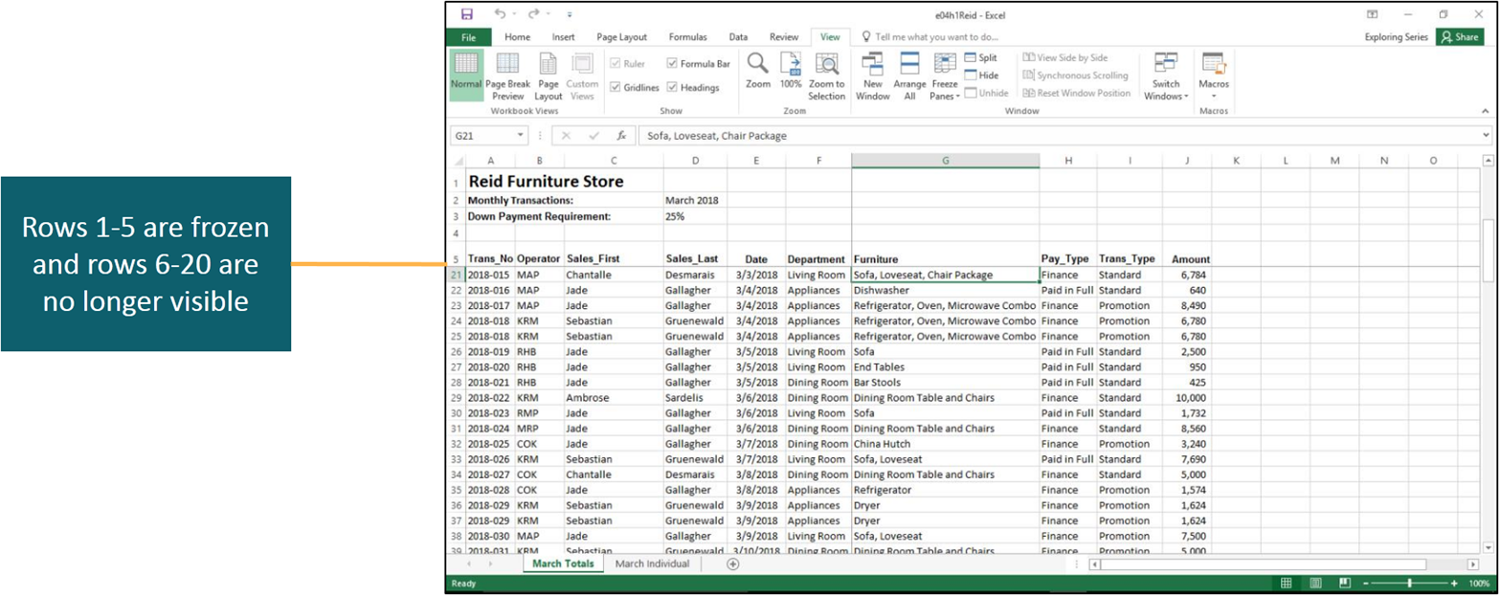
Freeze Rows and Columns (2 of 2)
Notes:
To freeze and unfreeze rows and columns, select the desired cell and click Freeze Panes in the Window group on the View tab. This displays a menu with the three options. When there are already frozen panes, Unfreeze Panes is one of the options.
In this slide, the top five rows have been frozen. As you can see, the data has been scrolled down and rows 6–20 are no longer visible.

Slide 7
Objective 2: Print Large Datasets
Skills:
Display and Change Page Breaks
Set and Clear a Print Area
Print Titles
Control Print Page Order
Notes:
In this section, the skills include:
Display and Change Page Breaks
Set and Clear a Print Area
Print Titles
Control Print Page Order

Slide 8
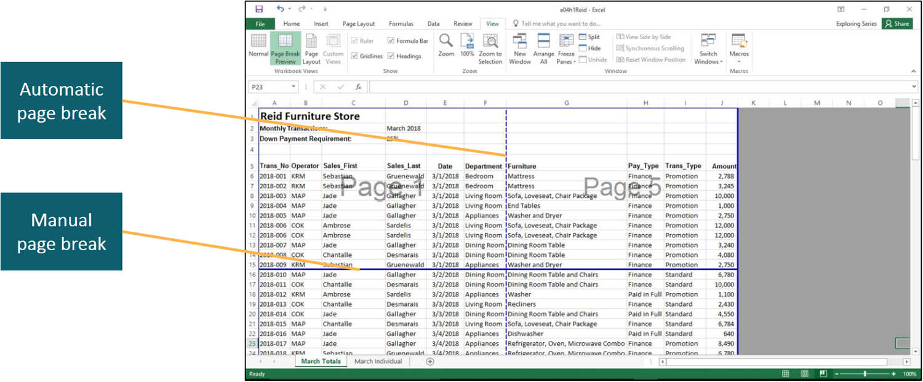
Print Large Datasets (1 of 3)
Notes:
A page break indicates where data will start on another printed page. Manual page breaks are added and removed by clicking Breaks in the Page Setup group on the Page Layout tab, and selecting the appropriate action. The dashed line indicates an automatic page break and the solid line indicates a manual one.

Slide 9
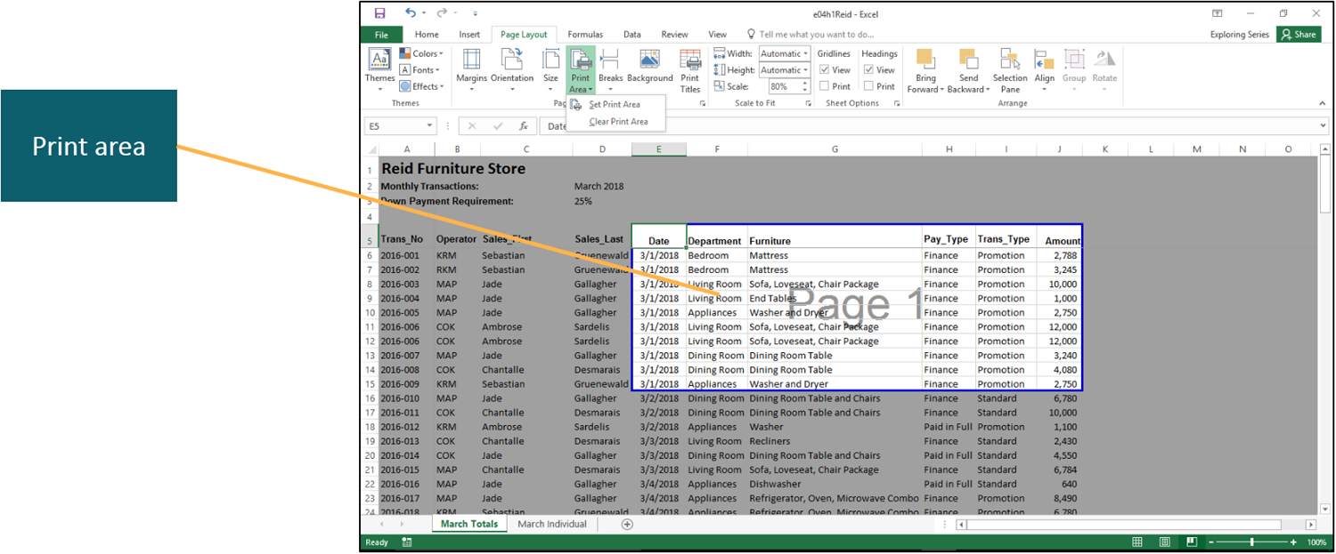
Print Large Datasets (2 of 3)
Notes:
The print area is the selected range of cells that will print. You set or clear the print area by clicking Print Area in the Page Setup group, and selecting the appropriate action. The white section with Page 1 is the print area for the indicated selection.

Slide 10
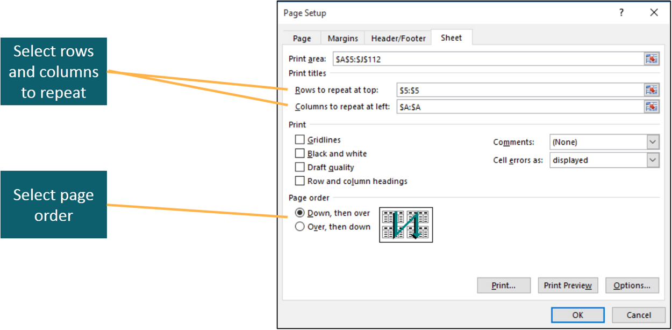
Print Large Datasets (3 of 3)
Notes:
When printing large datasets, it is helpful if every page contains descriptive column and row labels. To do this, click Print Titles in the Page Setup group to open the Page Setup dialog box, and select the desired options.
Print order is the sequence in which the pages are printed. The default order is to print top-left section, bottom-left section, top-right section, and bottom-right section. As seen in the figure on the slide, Page Order is one of the options in the Page Setup dialog box.

Slide 11
Objective 3: Understand the Benefits of Data Tables
Skills:
Understand the Benefits of Data Tables
Notes:
In this section, the skill is:
Understand the Benefits of Data Tables

Slide 12
Understand the Benefits of Data Tables
Data structure—organization method to manage multiple data points
Table advantages:
Column headings remain onscreen
Sorting and filtering is more efficient
Table styles easily format tables
Calculated columns enable you to create and edit formulas
Calculated total row implements summary functions
Structured references used in formulas
Table data can be exported
Notes:
Data structure is the organization method used to manage multiple data points within a dataset. For example, a dataset of students may include names, grades, email address, and major. The data structure of this dataset would define how you would store, organize, and access the information.
Some advantages of tables over using ranges include:
• Column headings remain onscreen
• Sorting and filtering is more efficient
• Table styles easily format table rows and columns
• Calculated columns enable you to create and edit formulas
• Calculated total row enables you to implement summary functions
• Structured references instead of cell references can be used in formulas
• Table data can be exported to a SharePoint list

Slide 13
Objective 4: Design and Create Tables
Skills:
Create a Table
Rename a Table
Add and Delete Fields
Add, Edit, and Delete Records
Remove Duplicate Rows
Notes:
In this section, the skills include:
Create a Table
Rename a Table
Add and Delete Fields
Add, Edit, and Delete Records
Remove Duplicate Rows

Slide 14
Design and Create Tables (1 of 4)
Table—group of related data organized in rows and columns
Field—individual piece of data in a column
Record—collection of related data about one entity in a row
Notes:
A table is a group of related data organized in a series of rows and columns that is managed independently from any other data on the worksheet.
Each column in a table represents a field, which is an individual piece of data.
Each row in a table represents a record, which is a collection of related data about one entity.

Slide 15
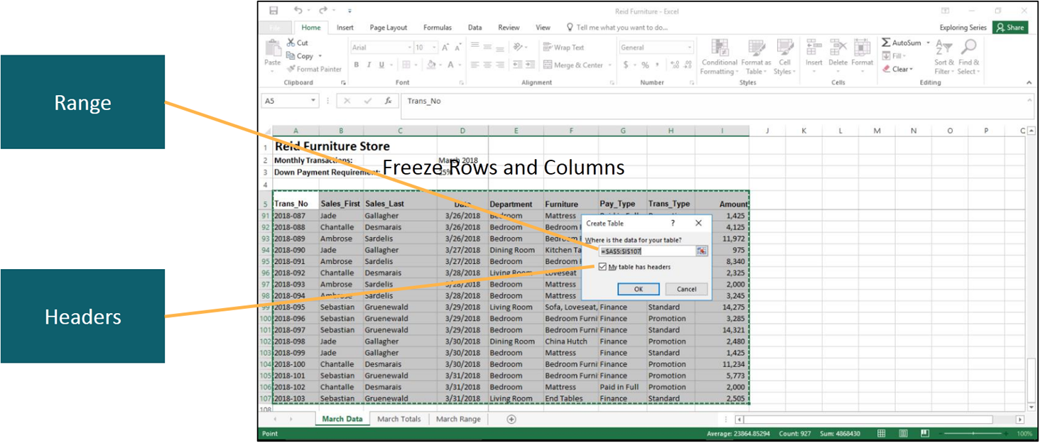
Design and Create Tables (2 of 4)
Notes:
To create a table from existing data, click within the existing range of data and click Table in the Tables group on the Insert tab. This opens the Create Table dialog box. As seen in the slide, you can accept the range determined by Excel or change it. You also indicate if the table has headers, which in this example, it does.

Slide 16
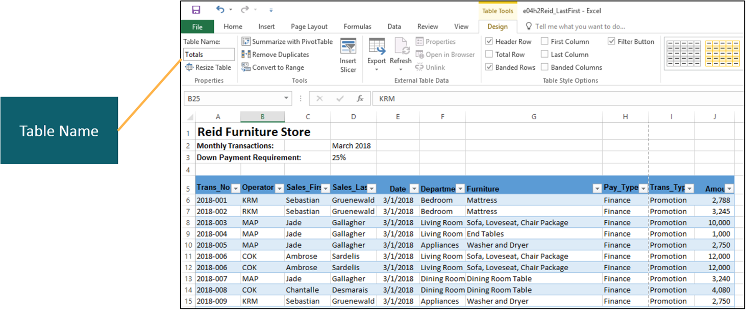
Design and Create Tables (3 of 4)
Notes:
To change the table name, click the Table Name box in the Properties group of the Table Tools Design tab and type the new name.

Slide 17
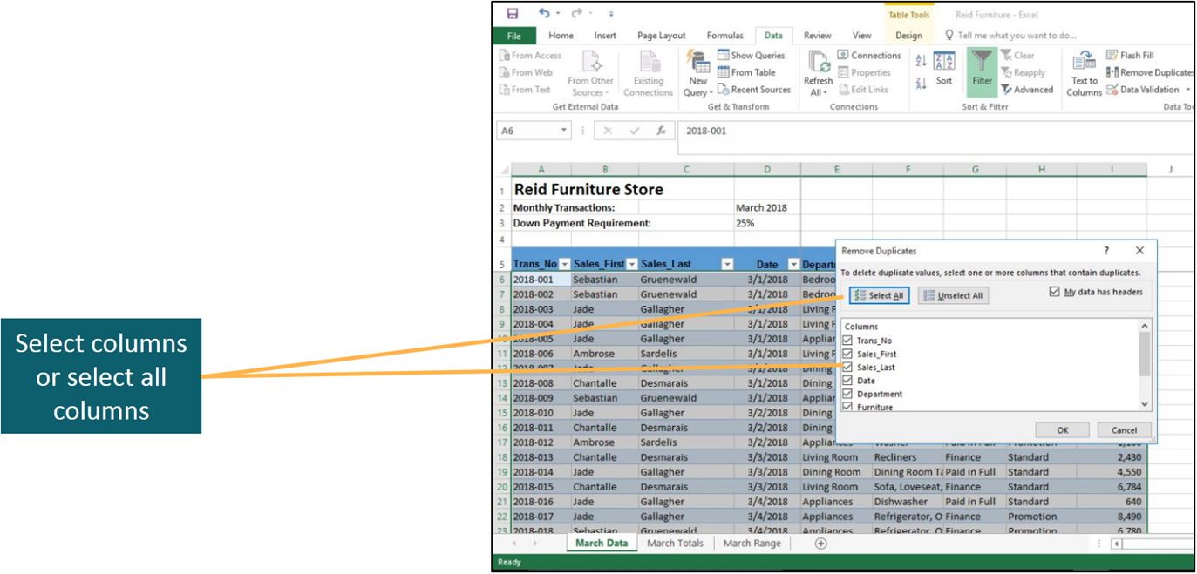
Design and Create Tables (4 of 4)
Notes:
Fields and records can be inserted or deleted from a table using the Insert or Delete commands in the Cells group on the Home tab.
To remove duplicate records, click within the table and click Remove Duplicates in the Tools group on the Design tab to display the Remove Duplicates dialog box. As shown in the slide, you then check all or the columns in which you want to remove duplicate records.

Slide 18
Objective 5: Apply a Table Style
Skills:
Apply a Table Style
Notes:
In this section, the skill is:
Apply a Table Style

Slide 19
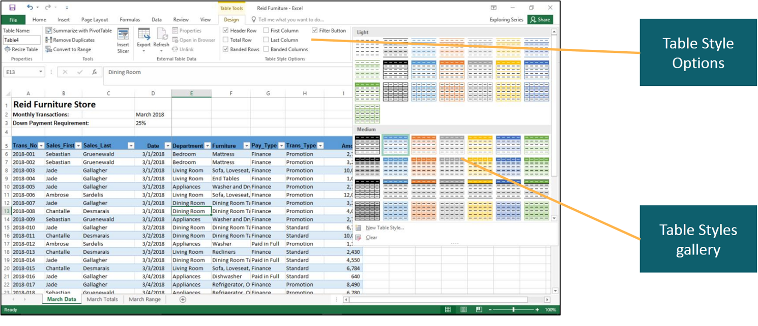
Apply a Table Style
Notes:
Table styles control the fill color of the header row and rows of records, and specify bold and border lines. To display the Table Styles gallery, click More in the Table Styles group on the Design tab.
After a table style has been selected, you can control the style formats by selecting check boxes in the Table Styles group.

Slide 20
Objective 6: Create Structured References in Formulas
Skills:
Create a Structured Reference in a Formula
Notes:
In this section, the skill is:
Create a Structured Reference in a Formula

Slide 21
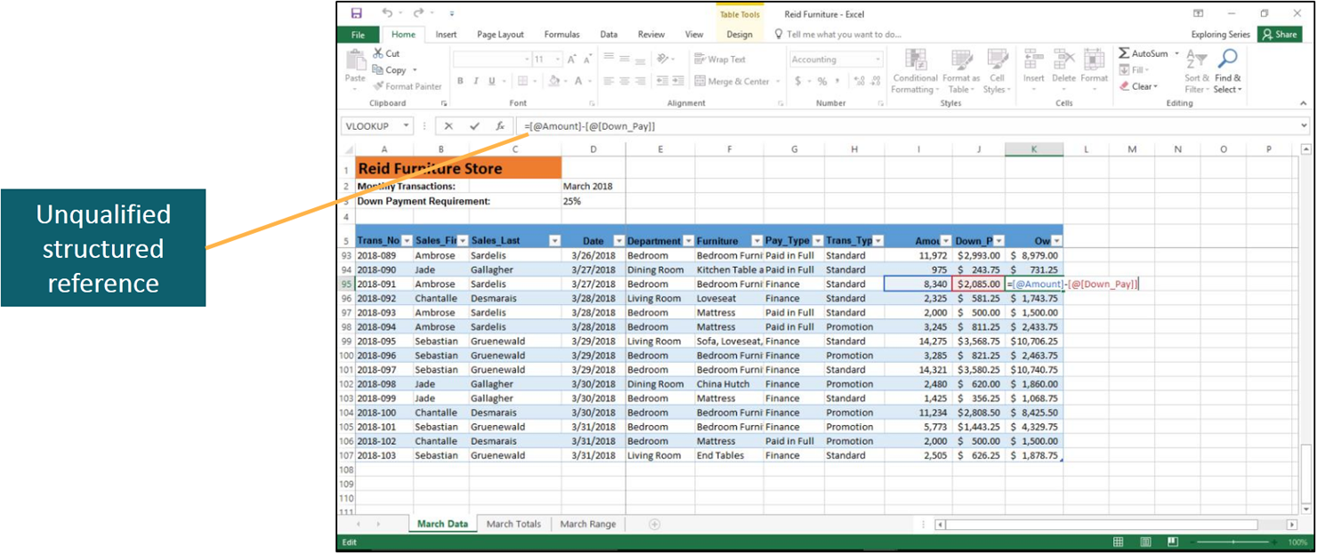
Create Structured References in Formulas
Notes:
A structured reference is a tag or use of a table element, such as a field heading, as a reference in a formula. Your experience in creating formulas has involved using cell references, such as =SUM(B1:B15) or =H6*$B$3. When creating a formula in a table using structured references, field headings are set off by brackets around column headings or field names.
The use of field headings without row references in a structured formula is called an unqualified reference.
A structured formula that includes references, such as table name, is called a fully qualified structured reference.
When building formulas within a table, you can use either unqualified or fully qualified structured references. When using table data in a formula outside the table boundaries, you must use fully qualified structured references.
The figure in the slide shows a structured reference. The @ symbol indicates the current row.

Slide 22
Objective 7: Sort Data
Skills:
Sort One Field
Sort Multiple Fields
Create a Custom Sort
Notes:
In this section, the skills include:
Sort One Field
Sort Multiple Fields
Create a Custom Sort

Slide 23
Sort Data (1 of 3)
Data Type | Options | Explanatoin
Text | Sort A to Z | Arranges data in alphabetical order.
Blank | Sort Z to A | Arranges data in reverse alphabetical order.
Dates | Sort Oldest to Newest | Displays data in chronological order, from oldest to newest.
Blank | Sort Newest to Oldest | Displays data in reverse chronological order, from newest to oldest.
Values | Sort Smallest to Largest | Arranges values from the smallest value to the largest.
Blank | Sort Largest to Smallest | Arranges values from the largest value to the smallest.
Color | Sort by Cell Color | Arranges data together for cells containing a particular fill color.
Blank | Sort by Font Color | Arranges data together for cells containing a particular font color.
Notes:
There are four ways to sort using only one field:
Click in a cell within the field you want to sort and click Sort & Filter in the Editing group on the Home tab, and select a desired sort option.
Click in a cell within the field you want to sort and click Sort A to Z, Sort Z to A, or Sort in the Sort & Filter group on the Data tab.
Right-click the field to sort, point to Sort on the shortcut menu, and then select the type of sort you want.
Click the filter arrow in the header row and select the desired sort option.
Regardless of which method you use, there are several sorting options that depend on the type of data being sorted.

Slide 24
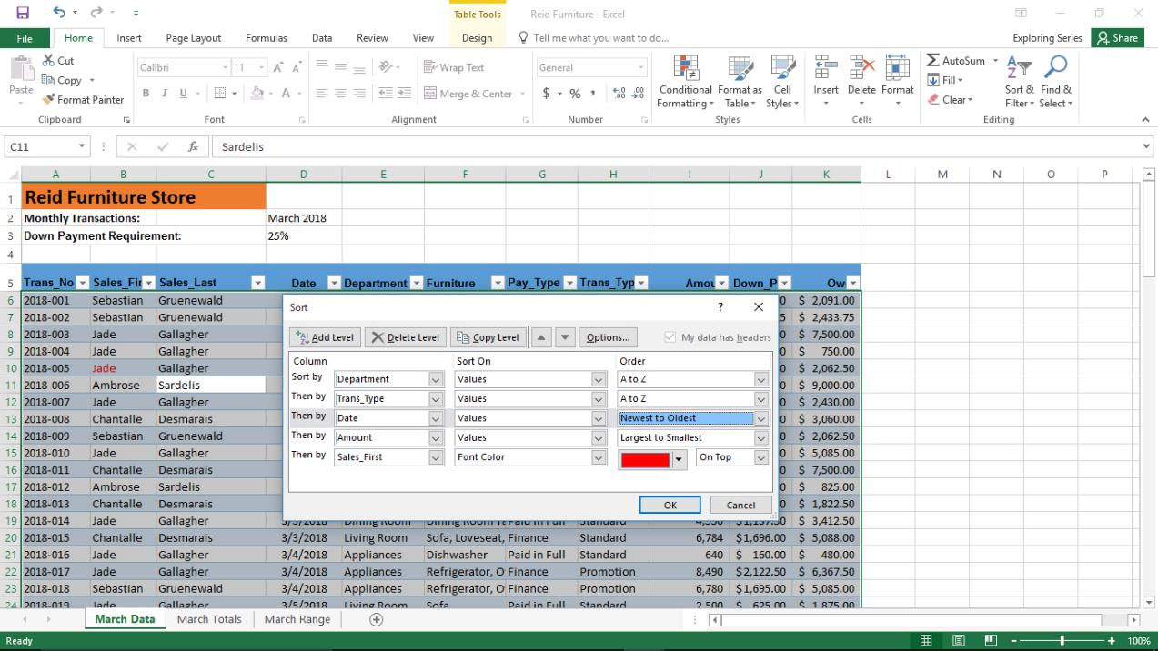
Sort Data (2 of 3)
Notes:
Performing a multiple level sort requires the use of the Sort dialog box. Click in any cell in the table, click Sort in the Sort & Filter group on the Data tab to display the Sort dialog box.
Select the primary sort level by clicking the Sort by arrow, selecting the field to sort by, and then clicking the Order arrow and selecting the sort order from the list.
Click Add Level, select the second sort level by clicking the Then by arrow, select the column to sort by, click the Order arrow, and then select the sort order from the list.
Continue to click Add Level and add sort levels until you have entered all sort levels and then click OK.
As seen in the slide, the table is sorted by five levels, beginning with the department and ending with the salesperson’s first name.

Slide 25
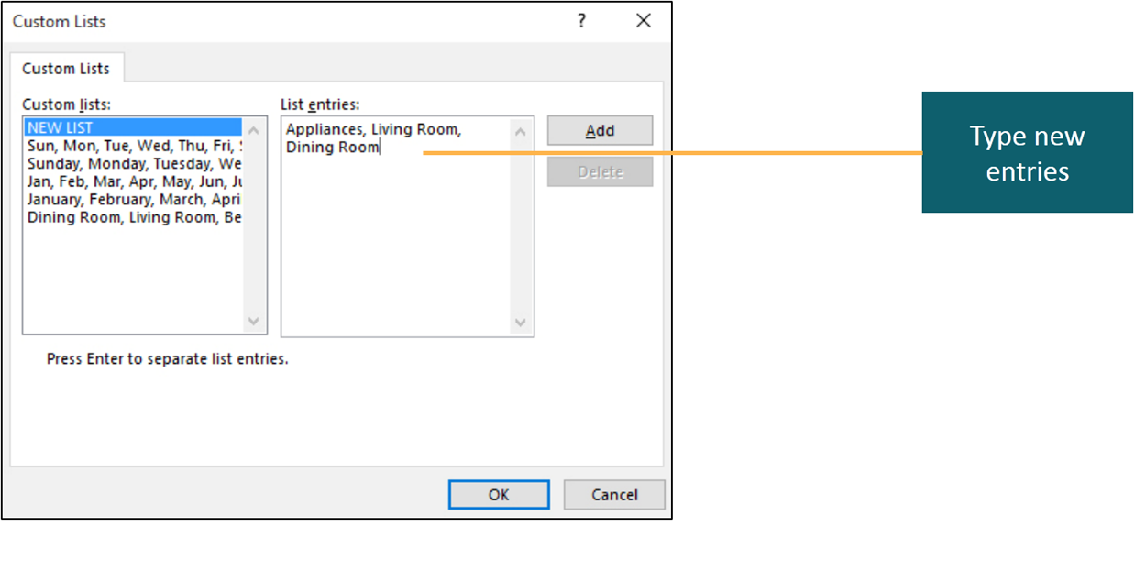
Sort Data (3 of 3)
Notes:
Excel arranges data in alphabetical or numerical order. For example, days of the week are sorted alphabetically: Friday, Monday, Saturday, Sunday, Thursday, Tuesday, and Wednesday. Excel enables you to create a custom sort sequence. For example, you can create a custom sort to arrange days of the week in order from Sunday to Saturday.
To create a custom sort sequence, click Sort in the Sort & Filter group on the Data tab, click the Order arrow and select Custom List to display the Custom Lists dialog box.
In the dialog box, select an existing sort sequence in the Custom lists box, or select NEW LIST. Type the entries in the desired sort sequence in the List entries box, click Add, and click OK.

Slide 26
Objective 8: Filter Data
Skills:
Apply Text Filters
Apply Number Filters
Apply Date Filters
Apply a Custom Filter
Notes:
In this section, the skills include:
Apply Text Filters
Apply Number Filters
Apply Date Filters
Apply a Custom Filter

Slide 27
Filter Data (1 of 5)
Filtering—only displays records that meet specified conditions
Filter types:
Text
Number
Date
Custom
Notes:
Filtering is the process of specifying conditions to display only those records that meet those conditions.
There are four types of filters:
Text
Number
Date
Custom

Slide 28
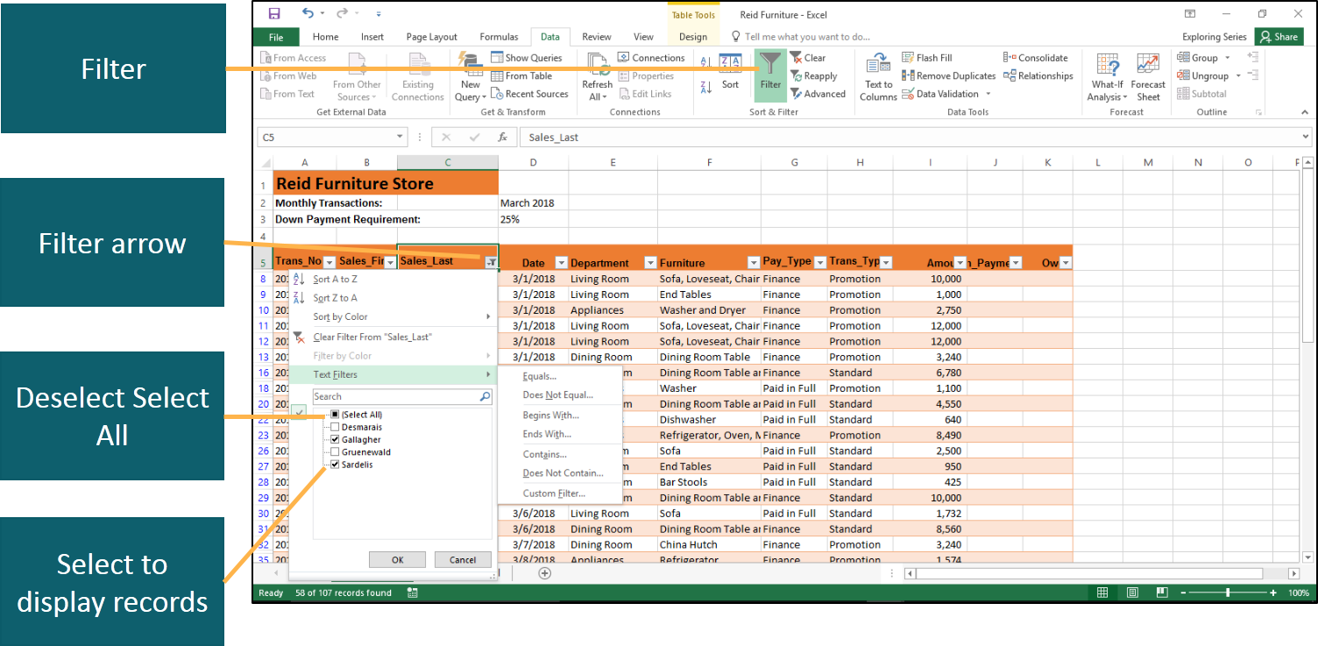
Filter Data (2 of 5)
Notes:
To apply a text filter, click any cell in the range of data to be filtered.
Click Filter in the Sort & Filter group on the Data tab to display the filter arrows.
Click the filter arrow for the column you will filter.
Deselect the (Select All) check mark.
Click the check boxes for the text you want to remain visible in the dataset.

Slide 29
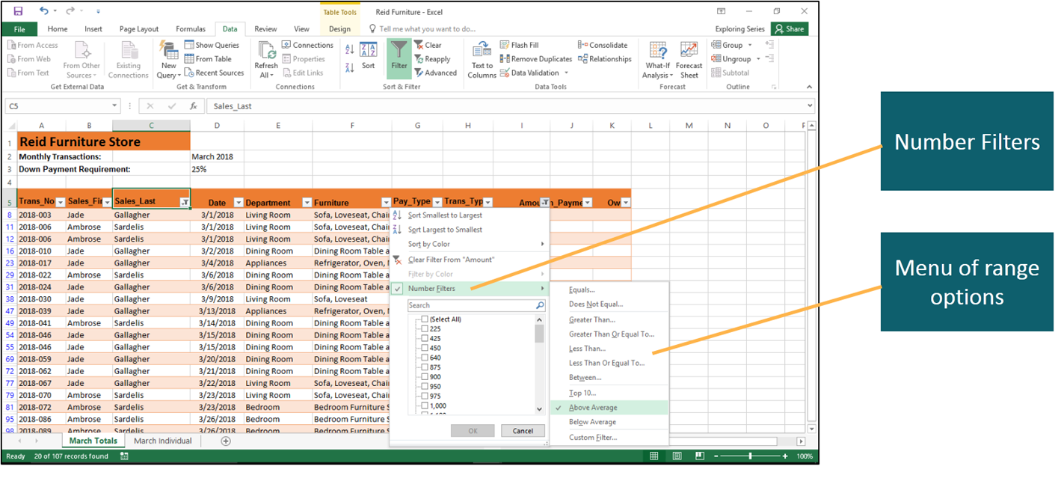
Filter Data (3 of 5)
Notes:
When filtering a field of numbers, you can select specific numbers or specify a range of numbers. To apply a number filter, you proceed in the same way as you did with a text filter. You click any cell in the range of data to be filtered.
Click Filter in the Sort & Filter group on the Data tab to display the filter arrows.
Click the filter arrow for the column you want to filter.
As seen in the slide, in addition to checking and unchecking specific values, you can click Number Filters to display a menu of range options.

Slide 30
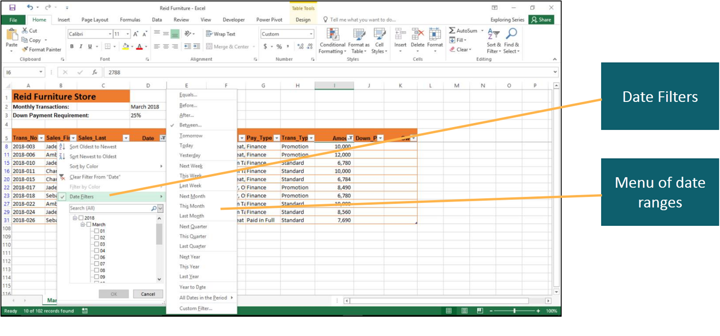
Filter Data (4 of 5)
Notes:
Similarly with dates, you can check and uncheck specific dates, or click Date Filters to display a menu of date ranges.

Slide 31
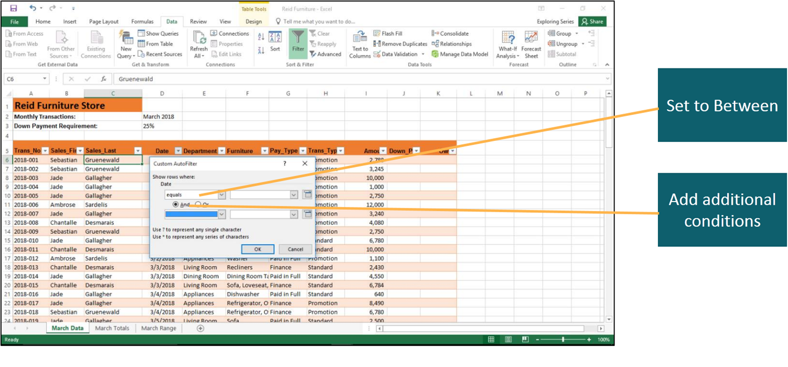
Filter Data (5 of 5)
Notes:
If none of the filter options meet your needs, you can create and apply a custom filter. The example in the text concerns a store manager who is looking for customers who spent between $500 and $1,000 in the past month. To display the Custom AutoFilter, click the filter arrow for the Date column, click Date Filters to display a menu of range options, and click Custom Filter. As shown in the slide, you can select the past month by using the Between option, and continue to add conditions using And to include the spending amounts.

Slide 32
Objective 9: Add a Row Total
Skills:
Add a Row Total
Notes:
In this section, the skill is:
Add a Row Total

Slide 33
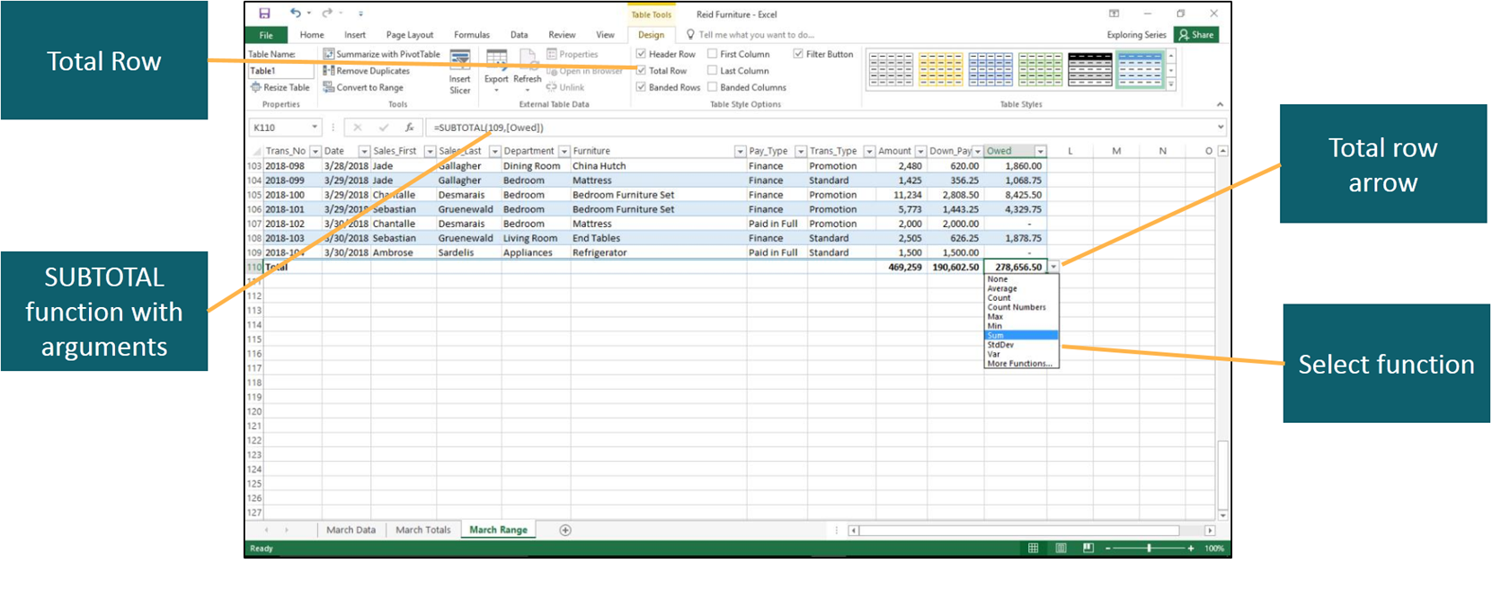
Add a Row Total
Notes:
You can add aggregate data to provide insightful information about a dataset using a total row. Click any cell in the table and select Total Row in the Table Style Options group on the Design tab.
Excel displays Total in the first column of the total row. Click a cell in the total row, click that cell’s total row arrow, and then select the statistical function that you want.
Despite its name, the SUBTOTAL function, used in the total row, calculates aggregate values, such as totals, averages, maximums, and minimums. The SUBTOTAL arguments consist of a function number and a reference to a range, table, or database. In the figure shown on the slide, 109 represents the SUM, and the range is [Owed], which represents the Owed field. See Table 4.4 for a list of the function numbers and their related functions.

Slide 34
Objective 10: Applying Conditional Formatting
Skills:
Apply Conditional Formatting with the Quick Analysis Tool
Apply Highlight Cells Rules
Specify Top/Bottom Rules
Display Data Bars, Color Scales, and Icon Sets
Notes:
In this section, the skills include:
Apply Conditional Formatting with the Quick Analysis Tool
Apply Highlight Cells Rules
Specify Top/Bottom Rules
Display Data Bars, Color Scales, and Icon Sets

Slide 35
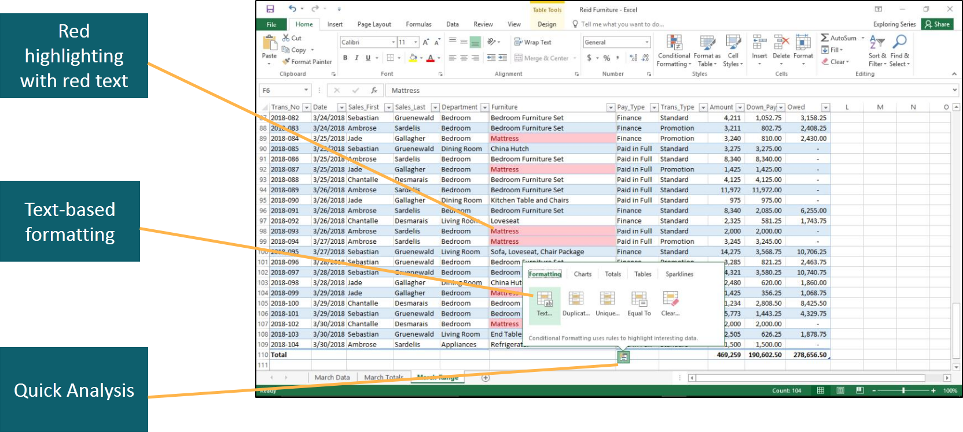
Applying Conditional Formatting (1 of 3)
Notes:
Conditional formatting applies special formatting to highlight or emphasize cells that meet specific conditions. You can use conditional formatting to help you understand a dataset better because it adds a visual element to the cells.
After selecting the range, you can apply conditional formatting in two ways. The first way is to click Quick Analysis to display the Quick Analysis formatting gallery and then select the desired formatting. Note that the range consists of text, so text-based formatting options are displayed. Conditional formatting previews the selected option, which in this example, is red highlighting with red text.

Slide 36
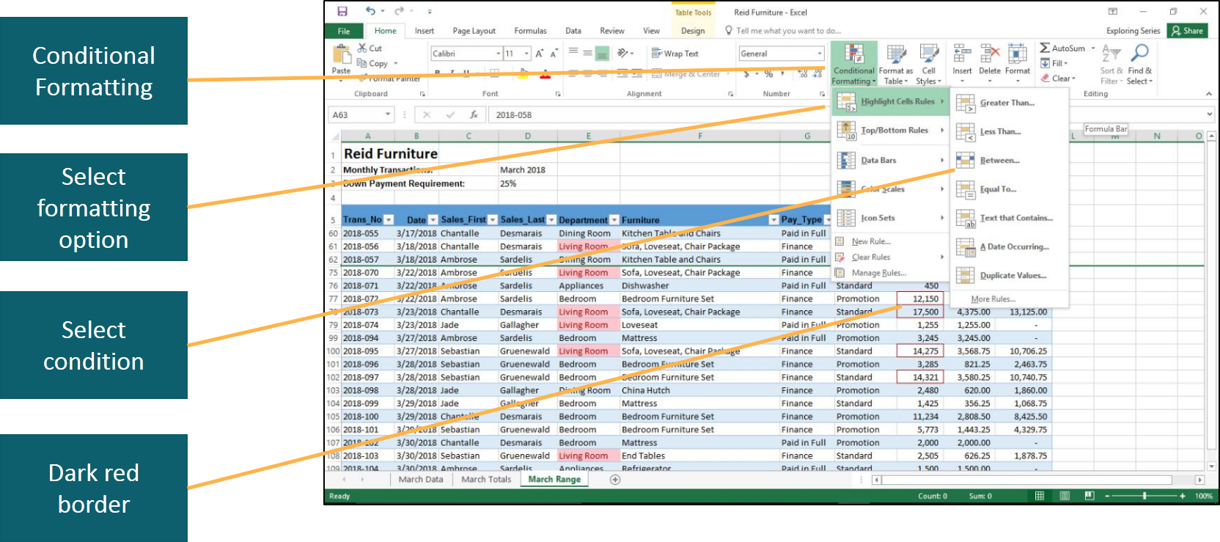
Applying Conditional Formatting (2 of 3)
Notes:
The second way is to click Conditional Formatting in the Styles group on the Home tab. In this example, a numeric range is selected, and the options are number-based. A dark red border is the conditional formatting that is applied to the cells.

Slide 37
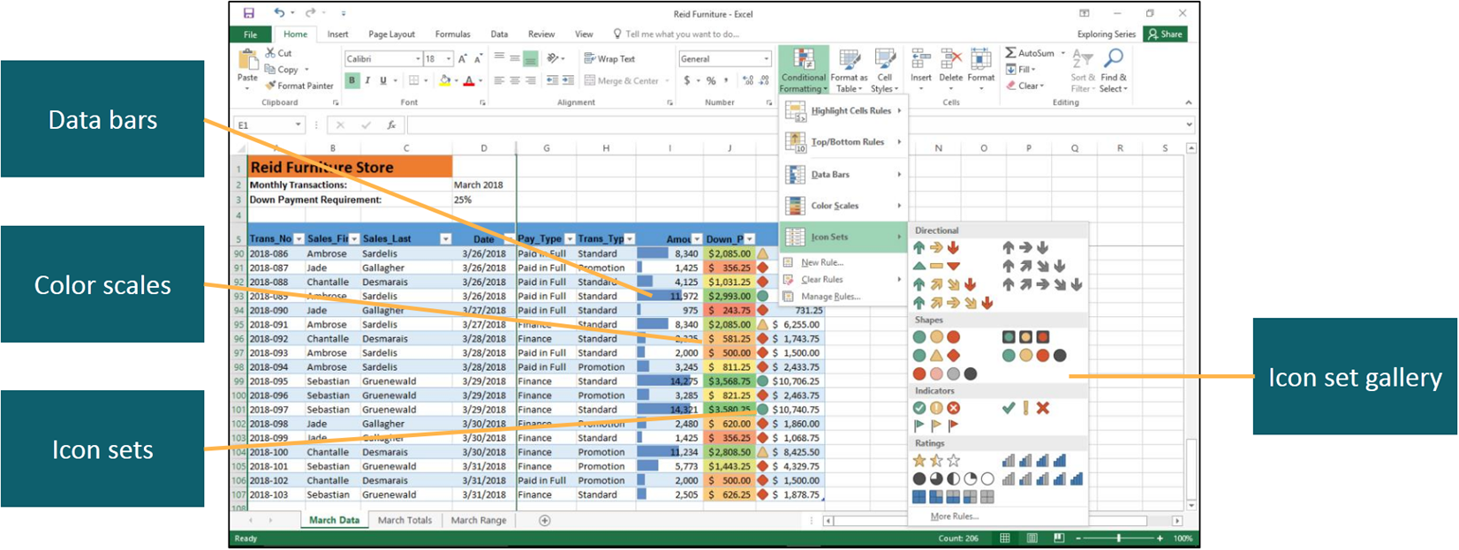
Applying Conditional Formatting (3 of 3)
Notes:
Data bars apply a gradient or solid fill bar where the width of the bar represents the current cell’s value compared to other cells’ values.
Color scales format cells with different colors based on the relative value of a cell compared to other selected cells.
Icon sets are symbols or signs that classify data into three, four, or five categories, based on the values in a range. There is a gallery of icons from which to choose.

Slide 38
Objective 11: Create a New Rule
Skills:
Use Formulas in Conditional Formatting
Manage Rules
Notes:
In this section, the skills include:
Use Formulas in Conditional Formatting
Manage Rules

Slide 39
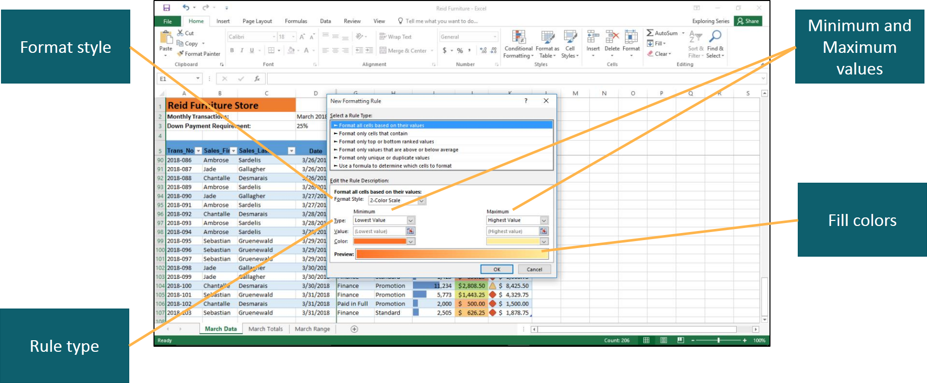
Create a New Rule (1 of 3)
Notes:
You can create your own rules to specify different fill colors, borders, or other formatting settings.
There are three ways to create a new rule. All three begin with the process of clicking Conditional Formatting in the Styles group and end with the display of the New Formatting Rule dialog box:
Select New Rule
Select Manage Rules to open the Conditional Formatting Rules Manager dialog box, and then click New Rule
Select a rule category and then select More Rules
In the New Formatting Rule dialog box:
Select a rule type.
Specify the format style.
Specify the minimum and maximum values.
Specify the fill colors for color sets or data bars, or the icons for icon sets.

Slide 40
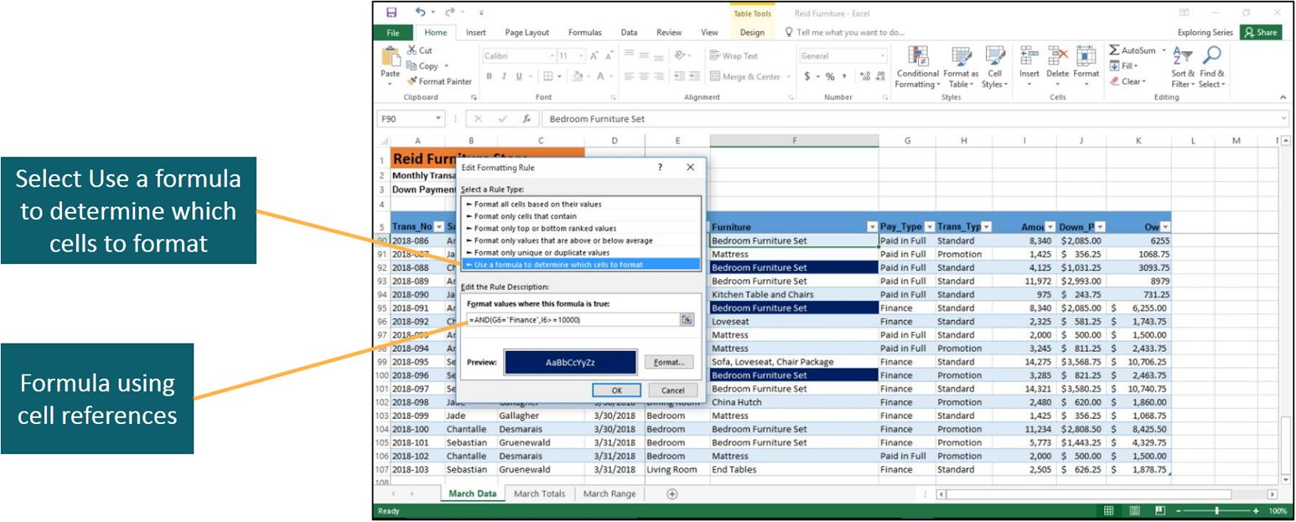
Create a New Rule (2 of 3)
Notes:
You can base conditional formatting on a formula instead of just selecting one of the options. To create a formula-based conditional formatting rule, select the desired data range and click New Rule as was done in the previous slide, and then:
Select Use a formula to determine which cells to format
Type the formula using cell references in the Format values where this formula is true box
Note the use of the AND function. It requires that both of the conditions specified in the formula are true. Specifically, the purchase was financed and was $10,000 or more.

Slide 41
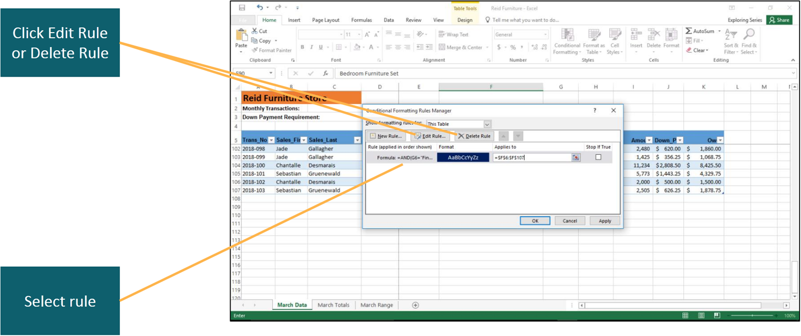
Create a New Rule (3 of 3)
Notes:
Periodically conditional formatting rules may need to be updated, moved, or even deleted.
To edit or delete conditional formatting rules, click Conditional Formatting and select Manage Rules to display the Conditional Formatting Rules Manager dialog box.
To edit a rule, select the rule, click Edit, and modify the rule. To delete a rule, select the rule and click Delete Rule.

Slide 42
Summary
In data stored as a range, you can freeze rows and columns to always display heading information
Converting a range to a table has several advantages:
Sorting and filtering
Adding aggregate statistical functions
Applying conditional formatting
Notes:
When dealing with large datasets, Excel provides some new tools to enable you to work efficiently:
If the data are stored as a range, you can freeze rows and columns so that heading information always displays.
Converting a range to a table has several advantages such as sorting and filtering the data, adding aggregate statistical functions, and applying conditional formatting.

Slide 43

Questions
Notes:
It is important to understand the skills learned in this chapter so you can build on these in future PowerPoint chapters. Are there any questions?

Slide 44

Copyright

